Slide 1
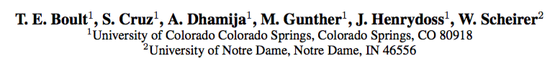
Learning and the Unknown: Surveying Steps Toward Open World Recognition
Terrance E. Boult
IEEE Fellow El Pomar Prof. of Innovation and Security University of Colorado Colorado Springs
I’ll post video of this talk at https://github.com/vastab
Notes:
The first part of the talk will explore issues with deep networks dealing with "unknowns" inputs, and the general issues of Open-Set recognition in deep networks. We review our first attempt at Open-Set deep networks, "OpenMax," and discuss is successes and limitations and why classic "open-set" approaches don't really solve the problem of deep unknowns. We then present our ongoing work, to first appear at NIPS2018, on a new model we call the ObjectoSphere. Using ObjectoSphere loss begins to address the learning of deep features that can handle unknown inputs. We present examples of its use first on simple datasets sets (MNIST/CFAR) and then on a real-world problem of open-set face recognition. We then move to another type of unknown for deep networks: adversarial examples, images perturbations that are invisible to humans but easily fool deep networks. While Open-Set recognition tries to deal with inputs that are "far" from known training samples, these adversarial examples are in perceptually close in input space but far in feature face. This last part of the talk will discuss various potential theories about the causes of adversarial examples, why we know those theories are not correct, and why they show we don't understand deep networks. We introduce our deep-feature adversarial approach, called LOTS, and return to the examples of object-recognition and face-recognition showing how our LOTS adversarial examples can successfully attack even open-set recognition systems.

Slide 2
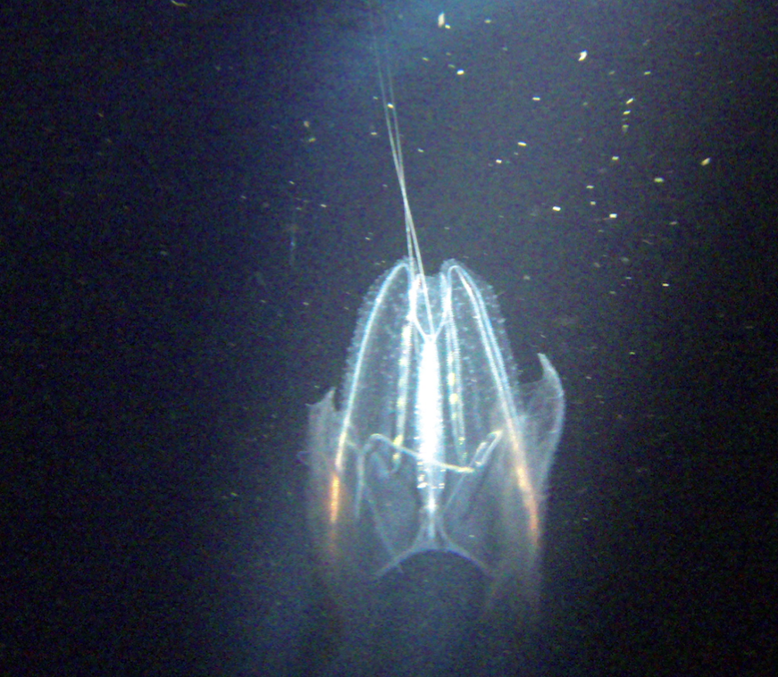
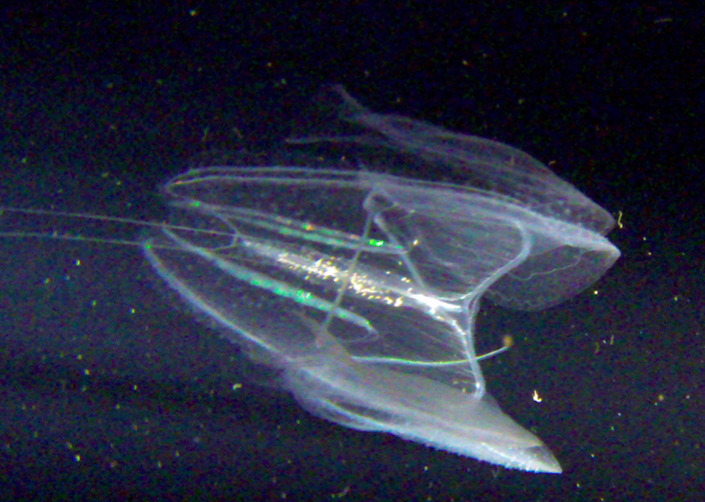
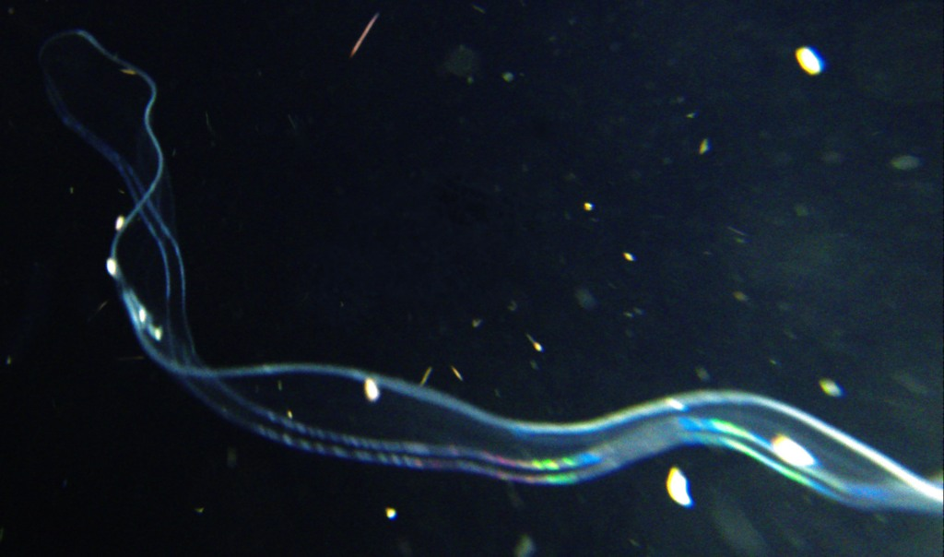
What “Class” is this Object?
A few will actually know it
Most will (quickly) think “I don’t know” – you know you don’t know which is OpenSet
The curious might try to look it up and get more data to “learn” it’s a Ctenophore aka a comb jelly – i.e. we do open world learning

Slide 3
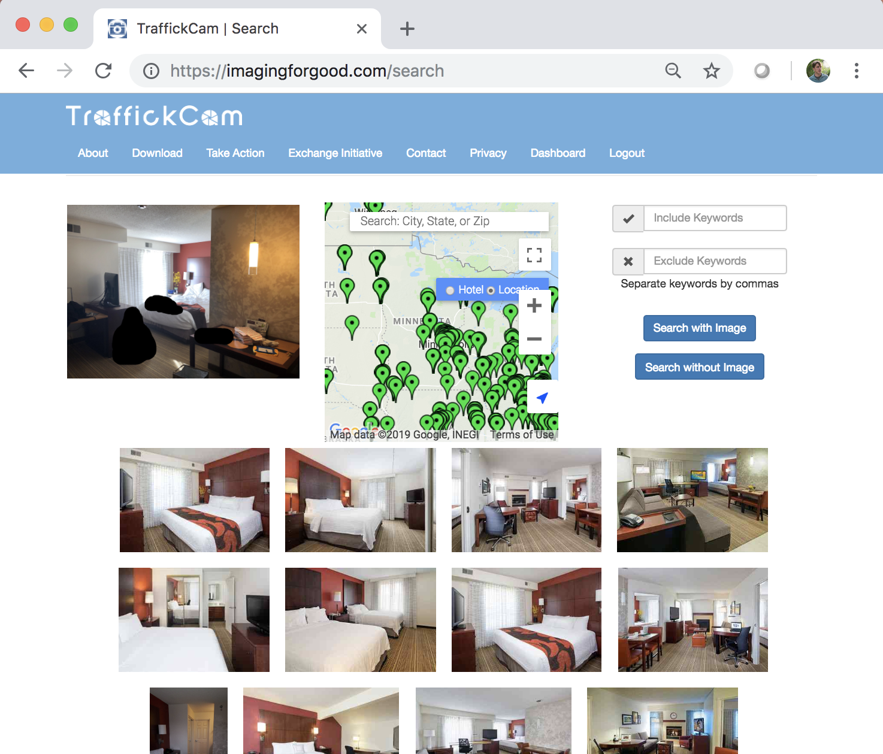
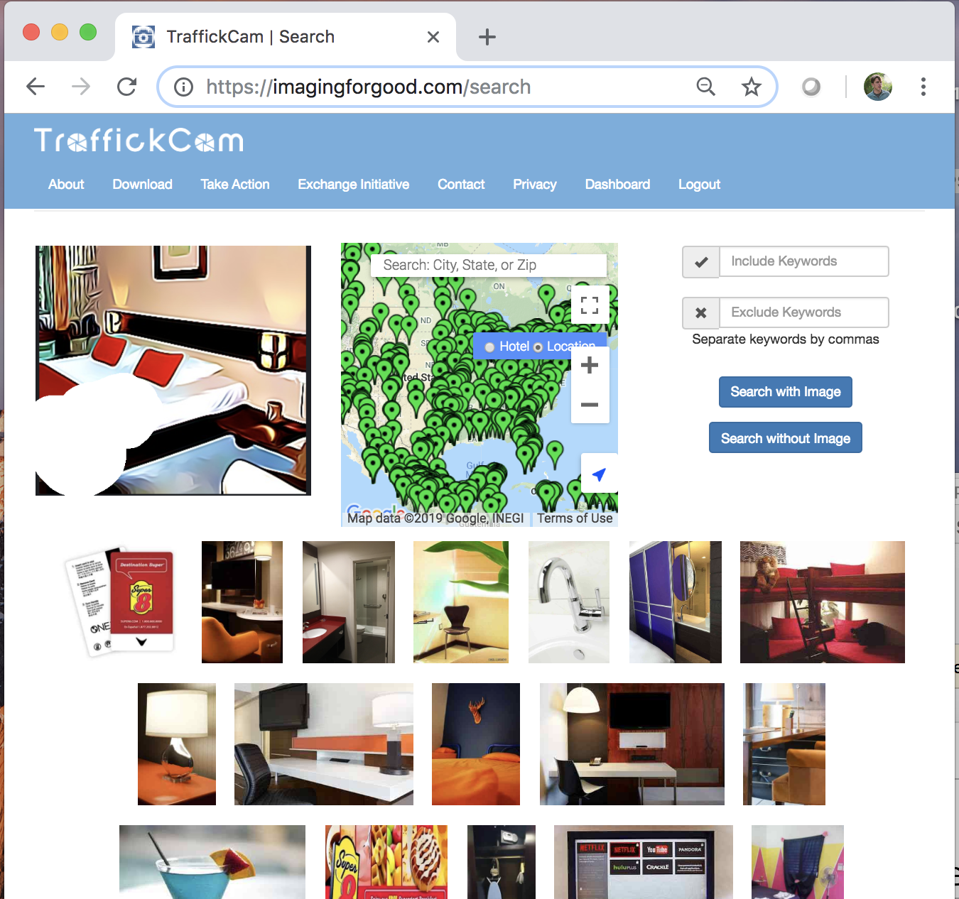
TraffickCam example (AAAI19 paper) Hotels-50K: A Global Hotel Recognition Dataset: Abby Stylianou, Hong Xuan, Maya Shende, Jonathan Brandt, Richard Souvenir, Robert Pless
Adversaries will try to defeat a system

Slide 4
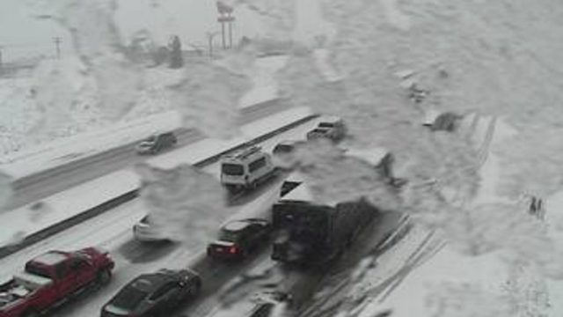
Surveillance example: Car detection/counting
Nature can produce persistent/long-lived unknown inputs
e.g. Ice on camera housing. (Also bug, bird doodoo…)

Slide 5
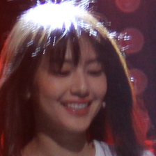
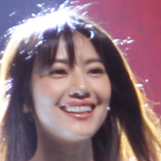
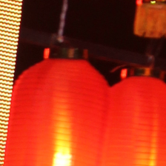
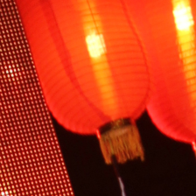
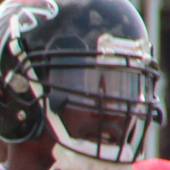
Face Verification (mid JANUS IARPA program)
Gallery
Probe
Match Score =0.72705

Slide 6
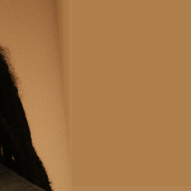
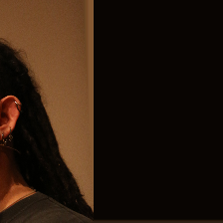
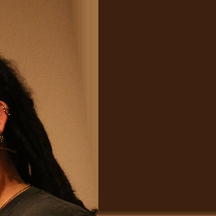
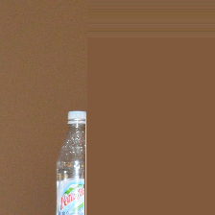

Face Verification (mid-JANUS IARPA program, top performer)
L2-Softmax trained Cosine-distance matching
Gallery
Probe
Match Score= 0.99769

Slide 7
What went wrong?
Absence of Evidence is not Evidence of Absence
Being far from boundaries & training evidence, A of E, implies high “probabilities” in classifiers such as SVM or Softmax
Bayesian Reasoning cannot help us as we cannot normalize without the probability of the unknown inputs
The open set/world is full of “unknowns” that will absent in training!

Slide 8
The Range of Openness/Unknowns in problems
Paper has > 90 citations covering OSR from 14 different application areas

Slide 9
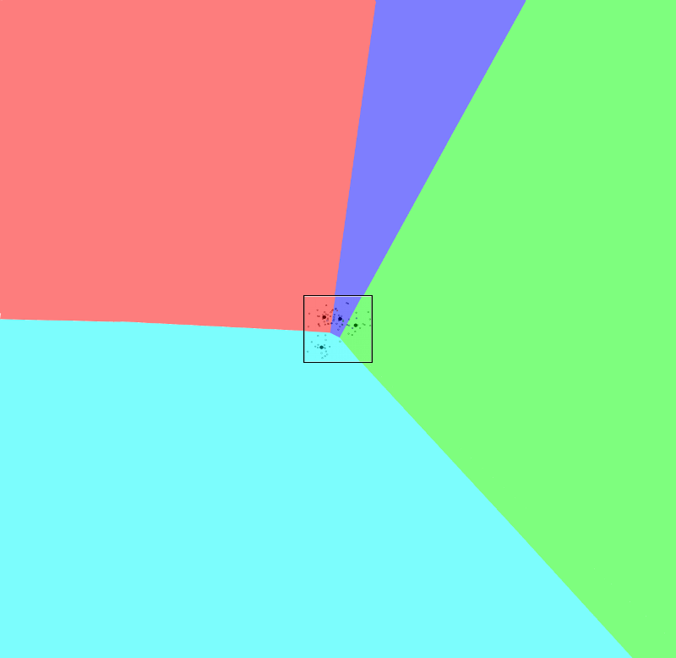
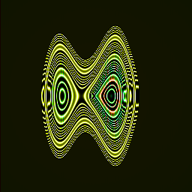
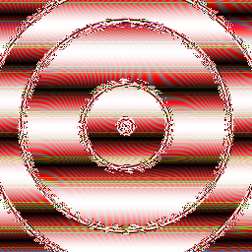
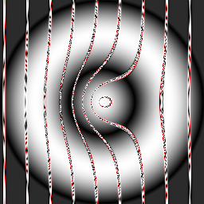
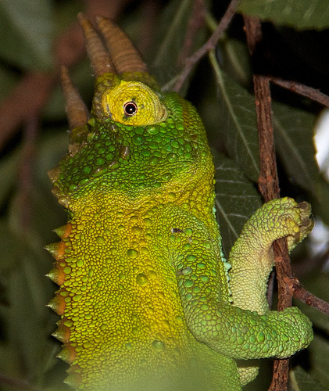
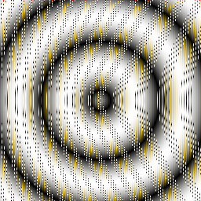

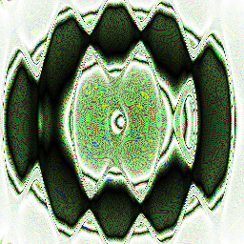
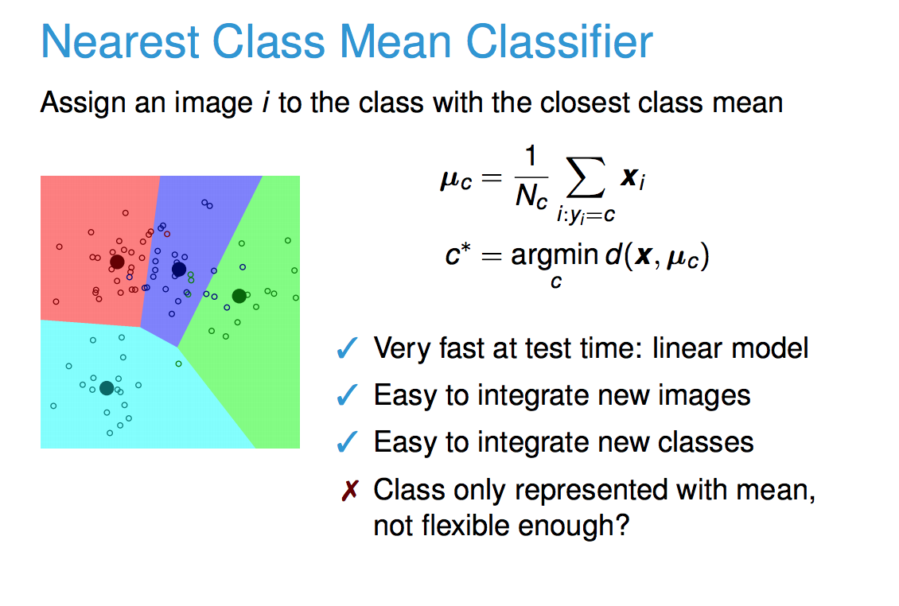
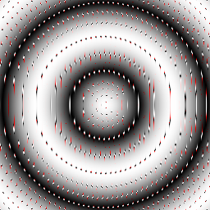

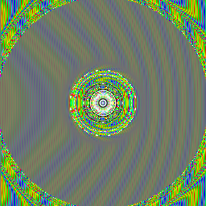

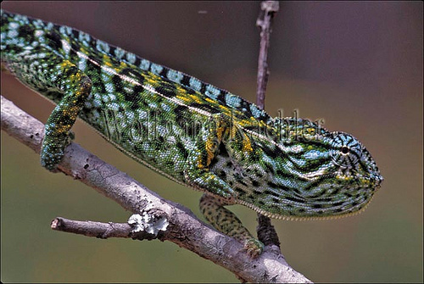
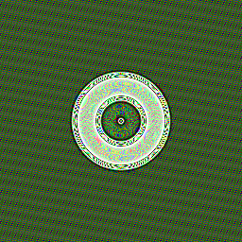
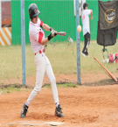
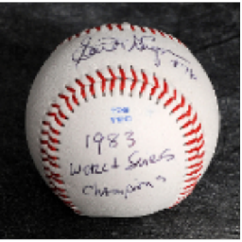
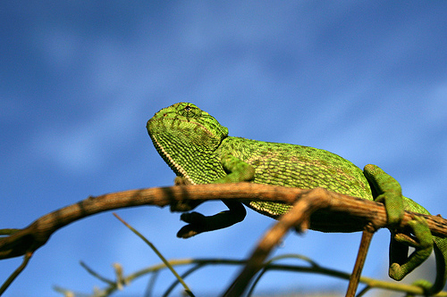
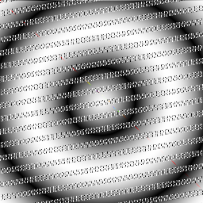
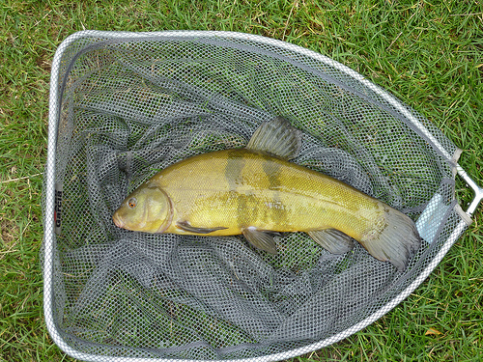
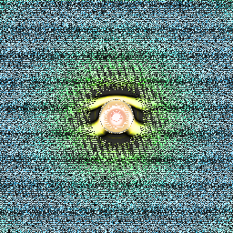
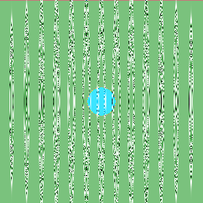
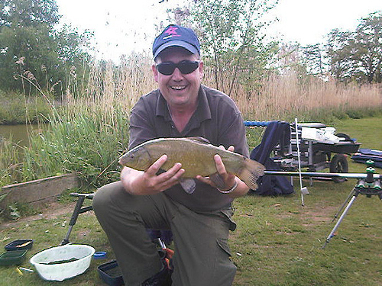
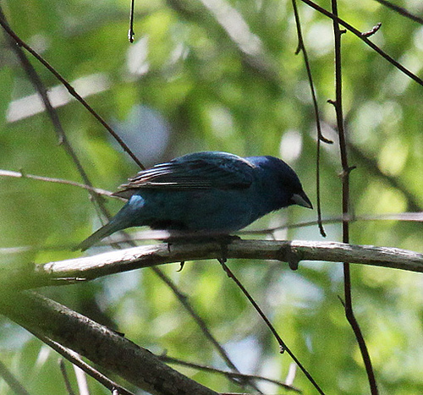
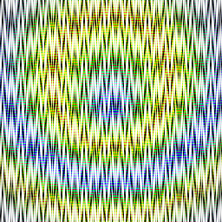
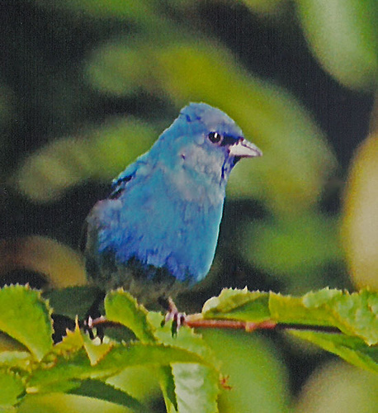
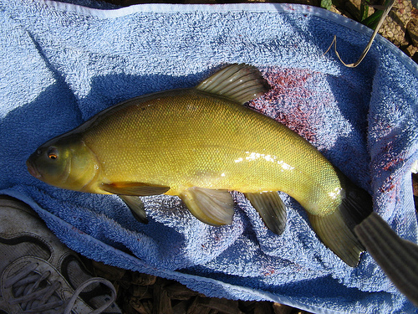

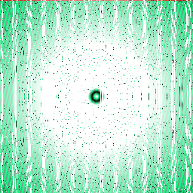
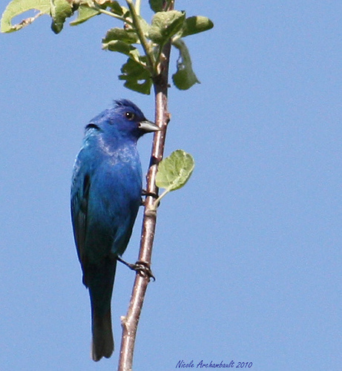

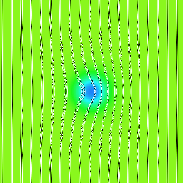
Thresholding “Probability” vs Open Set
On optimum recognition error and reject tradeoff. C. Chow, IEEE Trans. Info. Theory 16(1):41–46. 1970
Notes:
Why does this happen? We believe, the closed set nature of deep networks forces them to choose from one of the known classes leading to such artifacts. Our hypothesis is that deep networks suffer from the open space, prone to any discriminative classifier. The softmax layer divides the output space into N half spaces each with potentially infinite volume. However, recognition in the real world is Open-Set, i.e. the recognition system should reject unknown/unseen classes at test time.

Slide 10
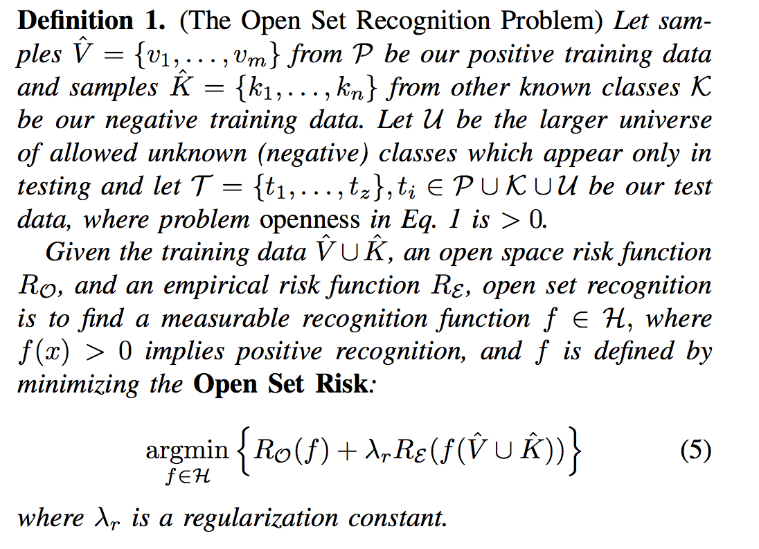
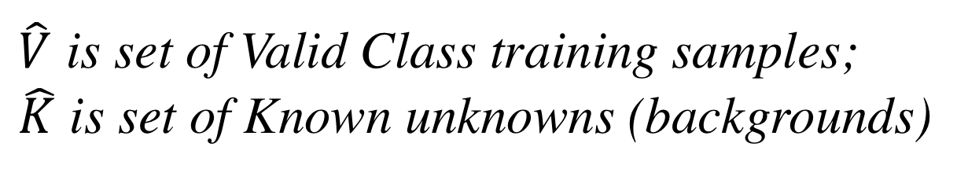
Learning in the face of Unknown Unknowns: Formalization of Open-Set Recognition
Open Space Risk
Empirical Risk/Error
$\hat{V}$ is set of Valid Class training samples;
$\hat{K}$ is set of Known unknowns (backgrounds)
Scheirer et al. TPAMI ‘13

Slide 11
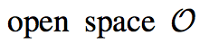
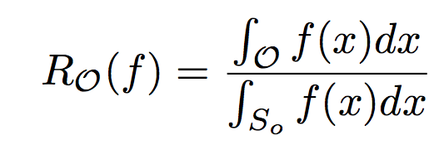
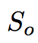
OPEN SPACE RISK
“open space” is the space far from known samples. A simple risk model a constant penalty for labeling that anything other than unknown in a ratio such as:

Slide 12
What solves OSR?
PI-SVM
Algorithms that solve OSR
WSVM
GMM
KDE
If they include a “bias” or Bayesian normalization they probably don’t solve OSR.
RBF SVM
SVDD
NNO
EVM
Any detector that uses pure linear classifiers, linear SVM, HAAR cascades, or Softmax-based classifiers, will almost always have an unbounded open set risk, and hence does not solve OSR even with thresholding.
Notes:
Gaussian Mixture Modules, kernel density estimators, RBF SVMs or Support Vector Data Descriptors (SVDD), may, but do not have to have bounded open space risk. It depends how they are combined and thresholded. If they include a “bias” they probably don’t solve OSR.

Slide 13
“Novelty detection, Anomaly detection and detecting “Out of Distribution Sample”
Long history and many many papers on the first 2, while the latter is a new term for similar ideas or learning with outliers.
Does NOT directly address “open set recognition” but can be used in sequence to address OSR. However, rarely is open set recognition part of evaluation evaluation.
Compute Novelty or Anomaly score
Is Outlier?
”Closed set” multi-class
Label
Unknown
Open-Set Recognition ≅
Anomaly/Novelty detection + Multi-class Recognition

Slide 14
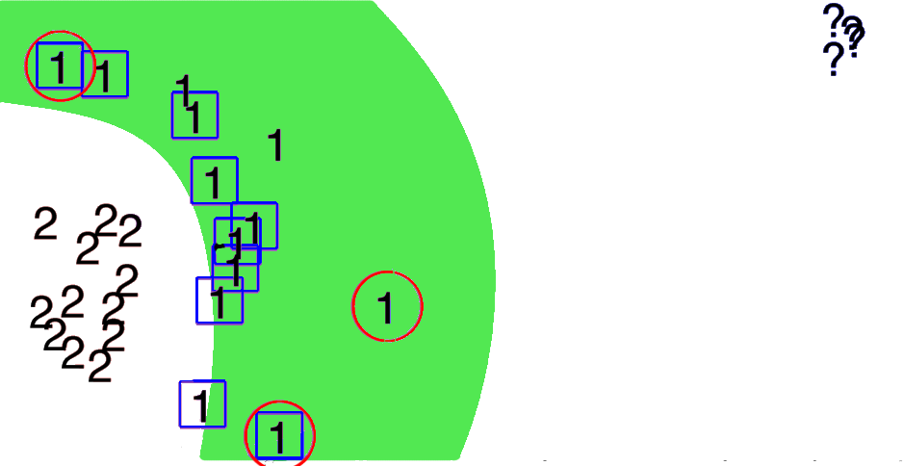
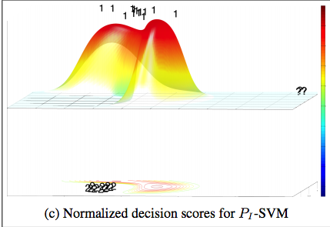



Thresholding vs Open Set
Classic machine learning presumes all classes known and classifies all of feature space.

Slide 15

Compact Abating Probability
W-SVM ~= OneClassRBF * (EVT scaled) Binary RBF SVM

Slide 16
There are many problem variants and Solutions
It can be a part of zero/few shot learning
Xian, Y.; Lampert, C. H.; Schiele, B.; and Akata, Z. 2018. Zero- shot learning-A comprehensive evaluation of the good, the bad and the ugly. IEEE TPAMI 2018.
Or Open set clustering/incremental with no labels
Active Sampling for Open-Set Classification without Initial Annotation Z-Y. Liu and S.-J Huang AAA19 (Tech Session 1: Weakly Supervised Learning 1 Thu 2-3:30, Coral Ballroom 3-5)
Problems where you have to predict scores on unseen data, e.g.
“An Open-World Extension to Knowledge Graph Completion Models” H. Shah et al AAAI 19 (Tech Session 3: Thu 10:25-11:25, Coral 2)

Slide 17

Open World Learning
World with Knowns (K) &
NU: Novel Unknowns
LU: Labeled Unknowns
Incremental Class Learning
OSR: Recognizes known classes or Detect as Unknown
Collect & Label Data
Known Unknowns (KU) Unknowns Unknowns (UU)
Scale Deploy
OpenSet Network Feature Training
Unknown
Class Label
Bendale-Boult CVPR15

Slide 18


Extreme Value Machine
Rudd Et Al. TPAMI 18
Uses our “margin distribution theorem” to derive EVT-based non-linear models that are provably Open-set and also can do Open World/”Incremental”. Can use classic or deep features

Slide 19




Towards Open-Set Deep Networks
Abhijit Bendale*, Terrance Boult
Samsung Research America*
University of Colorado of Colorado Springs
Notes:
Hi. I am Abhijit Bendale and I will present work on Towards Open-Set Deep Networks. This is joint work with Prof. Terrance Boult at University of Colorado.

Slide 20







OpenMax for Deep Networks
CAP Model using using EVT
On distances from MAV
Frequency
FC7
OpenMax
FC8
Distance from MAV
AlexNet

Slide 21


Open-Set Deep Networks
Model (MAV)
Real Image
Softmax: 0.94, baseball
Fooling Image
Softmax: 1.0, baseball
Open-Set Image
Softmax :0.15, baseball
Openmax : 0.94, baseball
Openmax: 0.00, baseball
0.95 Unknown
Openmax: 0.17, baseball
: 0.80, Unknown
Model (MAV)
Real Image
Fooling Image
Open-Set Image

Slide 22

OpenMax only somewhat better. We Researched Why.
Lenet++ 2D feature representation
Notes:
To explore the approaches we used LeNet++ which a has a 2D feature space just before the SoftMax classifier.

Slide 23


Training/Testing
Known:
MNIST
Known Unknowns NIST Letters

Slide 24


Rather than being far away or “outside” the data,
features for unknown inputs generally overlap known classes
LENET++ trained on MNIST
MNIST test set (Colors)
LENET++ trained on MNIST
MNIST test set (colors) Black = NIST Letters..

Slide 25

Observation from Default Response – Leading to Our Approach
Observer that there is difference in entropy and magnitude. While Open-Set limited response outside the ring of data, most of the unknowns had smaller magnitude.
The NeurIPS18 approach seeks to emphasize that difference.
Notes:
Observations leading to our NeuralIPS 18 spotlight paper

Slide 26

Goal of Our Approach

Slide 27



LENET++ RESPONSES TO KNOWNS AND UNKNOWNS. Colored dots represent test samples from the ten MNIST classes, while black dots represent samples from unknown unknowns. The dashed gray-white lines indicate class borders. The figures in the bottom are histograms of network scores for known (green) and unknowns (red) with logarithmic vertical axis.
Dhamija et al. 18

Slide 28

Dhamija et al. 18
Notes:
Performance of two new losses (red and green) are significantly better than any prior approach.

Slide 29

AISTATS ‘11

Slide 30


Matching Deep Features from VGG2 set at FAR=10⁻⁴ says this pic of TB matches Barack Obama
So does a commercial system
Adversarial Examples show we do NOT understand how deep network actually work– “Close in input is not close in features”. Until we do understand we cannot really do open world deep networks.

Slide 31
Conclusions
We cannot anticipate and train for all “unknown inputs”
Bayesian reasoning cannot help us if we don’t know probability of ”unknown” inputs occurring.
Almost all classical classifiers have unbounded risk and make highly confident errors. OSR tools address both.
Traditional deep network map unknown ontop of knowns
Starting to make progress on deep networks, but it’s a area with lots of research potential. Adversarial Examples show there is major issues still “unknown.

Slide 32
“Intelligence comes with hard work and curiosity for the unknown.” Roberto Llamas
Do not fear the unknown — join us in taming it.
https://github.com/vastab Our code is mostly LIBSVM or BSD-3 ”free” licensed.

